Slide 1
Rockbuster Stealth Data Analysis
Andy Cen

Slide 2

CONTEXT
Rockbuster Stealth LLC is a movie rental company that used to have stores around the world. Facing stiff competition from streaming services such as Netflix and Amazon Prime, the Rockbuster Stealth management team is planning to use its existing movie licenses to launch an online video rental service in order to stay competitive.

Slide 3

Key Questions
Which movies contributed the most/least to revenue gain?
What was the average rental duration for all videos?
Which countries are Rockbuster customers based in?
Where are customers with a high lifetime value based?
Do sales figures vary between geographic regions?

Slide 4
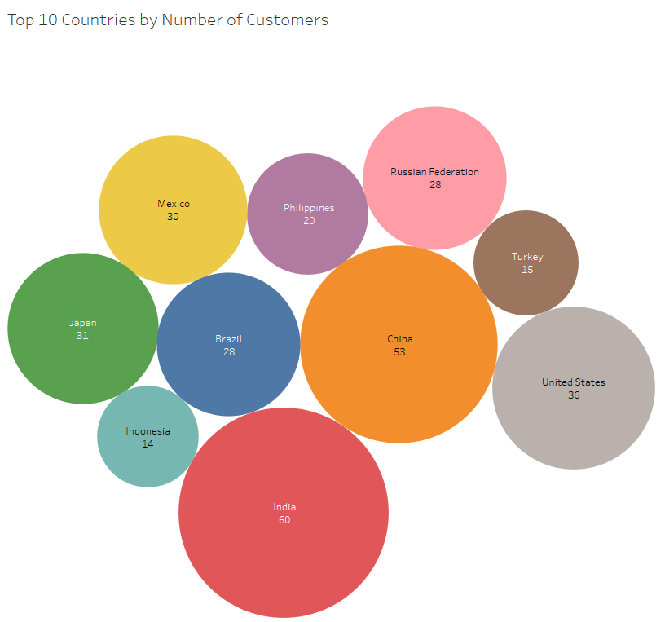
Which countries are Rockbuster customers based in? India has the greatest number of Customers.
Tableau Link

Slide 5
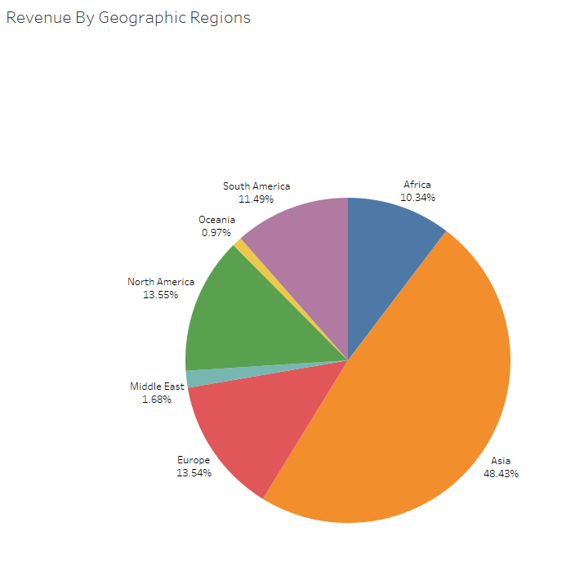
Do sales figures vary between geographic regions?
Tableau Link
Asia is leading in sales figures with over 48% of sales.

Slide 6
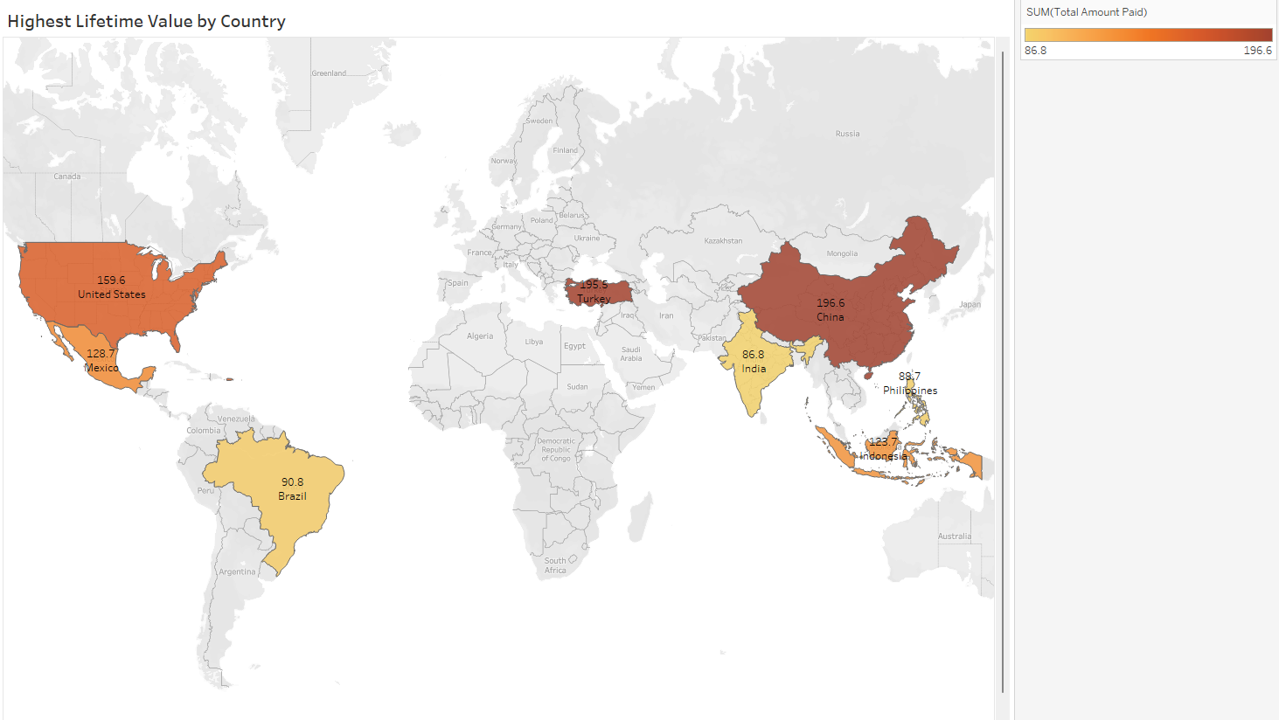
Where are customers with a high lifetime value based?
China and Turkey has the highest lifetime value of customers.
Unites States, Mexico, Indonesia follow behind.
Brazil, India, and the Philippines are last.
Tableau Link

Slide 7
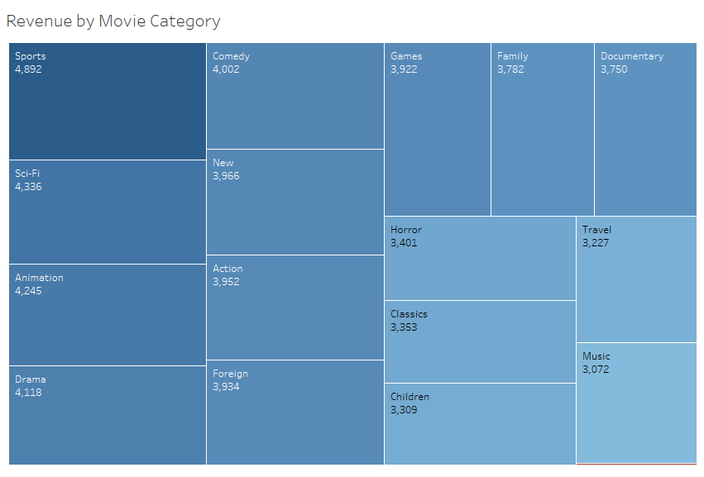
Revenue by Movie Category
Tableau Link
The top movie categories or genres are Sports, Sci-Fi Animation, Drama, and Comedy.
The sliver of red on the bottom right represents Thriller.

Slide 8
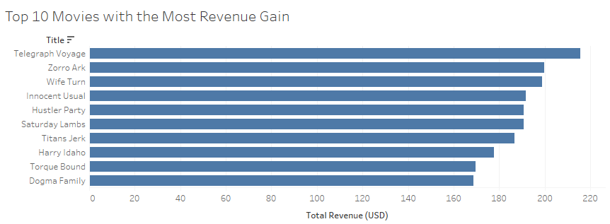
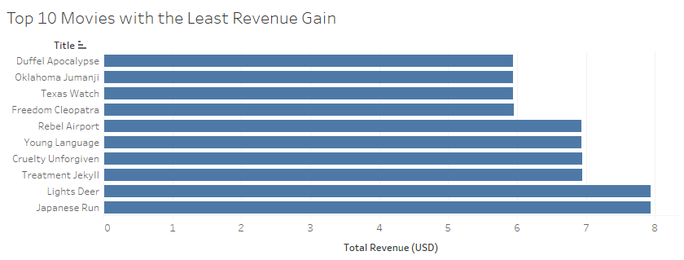
Which movies contributed the most/least to revenue gain?
Telegraph Voyage, Zorro Ark, and Wife Turn are the top movies with the most revenue gain.
Tableau Link
Duffel Apocalypse, Oklahoma Jumanji, Texas Watch, and Freedom Cleopatra are the movies with the least revenue gain.
Tableau Link

Slide 9
Key Insights
India has the great number of customers with 60 customers.
Asia is leading in sales figures with 48.43% of sales.
China and Turkey has the highest lifetime value of customers.
The top movie genres are Sports, Sci-Fi Animation, Drama, and Comedy.
Telegraph Voyage, Zorro Ark, and Wife Turn are the top movies with the most revenue gain.

Slide 10
Additional insights
The average rental duration is 5 days.
The average rental rate is $2.89.
The number of total customers is 599.
The number of participating countries is 108.

Slide 11
Recommendations
Global Market Expansion:
Asia has over 48% of Rockbuster’s sales and revenue. Exerting more resources and engagement into Asia’s market may better improve profits.
Consider the lesser popular regions like Oceania and the Middle East to expand and explore potential markets.
Loyalty Programs:
Offer customers with high contributions with great support and customer service. Include special offers and events that provide special privileges like early access, reduce prices, or rewards.
Top Performing Categories & Genres:
Top movie categories or genres are Sports, Sci-Fi Animation, Drama, and Comedy. Rockbuster should consider promoting these genres more since they generate high revenue.
Capitalize on Top Revenue Generating Movies:
Top revenue generating movies like Telegraph Voyage and Zorro Ark should be advertised and promoted more to yield more profits.

